Slide 1


NOTION ENTERPRISE SEARCH
SAN FRANCISCO, CA
MAY 2025

Slide 2

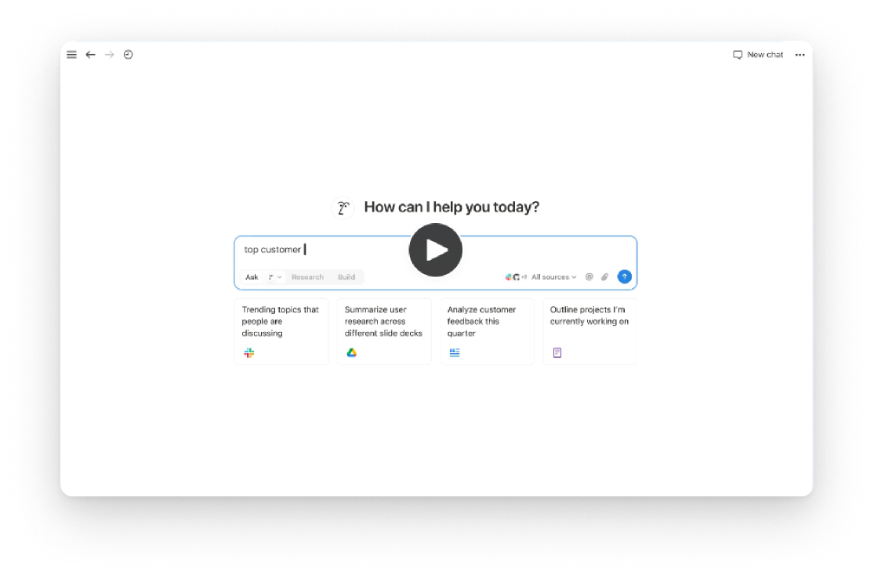
INTRODUCTION
Every Answer, One Search
NOTION ENTERPRISE SEARCH EMPOWERS TEAMS TO FIND
ANSWERS INSTANTLY AND GENERATE DETAILED REPORTS
IN MINUTES, ALL WITHIN A UNIFIED PLATFORM.
MAY 2025

Slide 3

KEY FEATURES OVERVIEW
UNIFIED SEARCH ACROSS TOOLS: INTEGRATE WITH SLACK, GOOGLE DRIVE, JIRA, GITHUB, AND MORE.
INSTANT ANSWERS WITH CONTEXT: RETRIEVE UP-TO-DATE INFORMATION WITH CITATIONS.
RESEARCH MODE: GENERATE COMPREHENSIVE REPORTS FROM MULTIPLE SOURCES.
CUSTOMIZABLE AI MODELS: CHOOSE PREFERRED AI MODELS FOR TAILORED RESULTS.
SECURE AND COMPLIANT: ADHERES TO SOC 2, ISO 27001, GDPR, AND CCPA STANDARDS.
MAY 2025

Slide 4

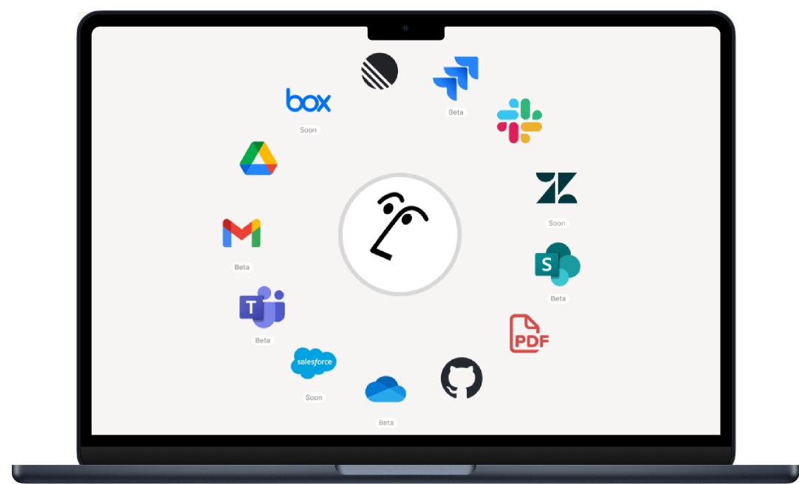
UNIFIED SEARCH ACROSS TOOLS
FIND ANSWERS, WHEREVER THEY’RE HIDING
WITH AI CONNECTORS, NOTION AI SEARCHES ACROSS ALL INTEGRATED TOOLS TO PROVIDE PRECISE INFORMATION, ELIMINATING THE NEED TO SWITCH BETWEEN PLATFORMS.
MAY 2025

Slide 5


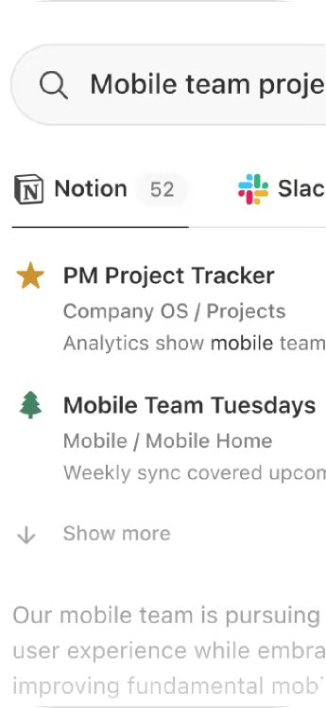
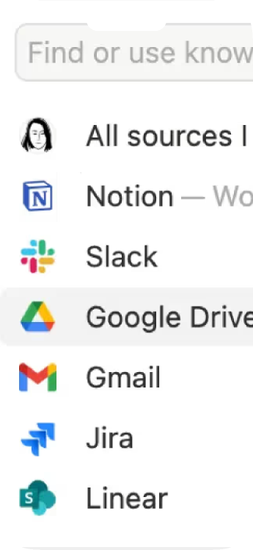
INSTANT ANSWERS WITH CONTEXT
GET UP-TO-DATE ANSWERS WITH CONTEXT
NOTION AI DELIVERS RELEVANT INFORMATION WITH PROPER CITATIONS, ENSURING YOU HAVE THE CONTEXT NEEDED TO MAKE INFORMED DECISIONS.
MAY 2025

Slide 6

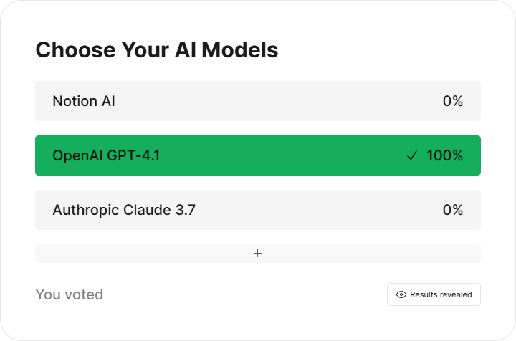
CUSTOMIZABLE AI MODELS
SELECT FROM VARIOUS AI MODELS TO TAILOR YOUR SEARCH AND ANALYSIS EXPERIENCE, ENSURING RESULTS ALIGN WITH YOUR TEAM'S NEEDS.
MAY 2025

Slide 7
ENTERPRISE SEARCH
Unified AI-powered search across all connected apps
$35/USER
CHATBOT
AI assistant that responds with real-time knowledge
$20/USER
MEETING TRANSCRIPTION
Auto-transcribes and summarizes meeting notes
$18/USER
WRITING ASSISTANT
AI-powered editing, summarizing, and rewriting
$20/USER
EMAIL ASSISTANT
Drafts and refines emails using AI context
$30/USER
MAY 2025

Slide 8
EMPOWER YOUR TEAM WITH NOTION ENTERPRISE SEARCH
STREAMLINE WORKFLOWS, ENHANCE PRODUCTIVITY,
AND ENSURE SECURE ACCESS TO INFORMATION—ALL WITHIN A SINGLE PLATFORM

